Slide 1


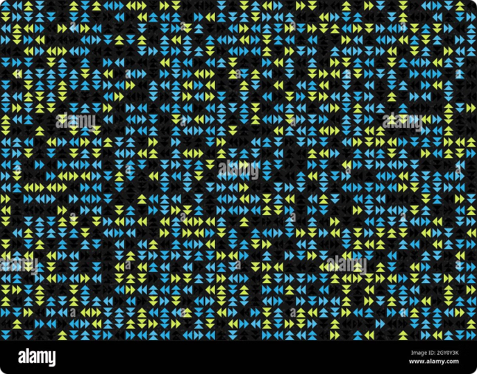

Introduction to Theory of Computation
The theory of computation explores the fundamental capabilities and limitations of computers and algorithms. It lays the groundwork for understanding computational processes, from the simplest finite automata to the powerful Turing machines.
S.Charan Kumar
192211364

Slide 2
Finite Automata
Definition
Applications
Limitations
Finite automata are mathematical models of computation that recognize regular languages. They have a finite number of states and transition rules.
Finite automata are used in text editors, compilers, network protocols, and pattern matching algorithms.
Finite automata can only recognize regular languages, which have a limited expressive power compared to more complex models.

Slide 3



Regular Languages
1
Definition
2
Closure Properties
Regular languages are the set of languages that can be recognized by finite automata.
Regular languages are closed under operations like union, concatenation, and Kleene star.
3
Applications
Regular languages are widely used in text processing, pattern matching, and lexical analysis.

Slide 4

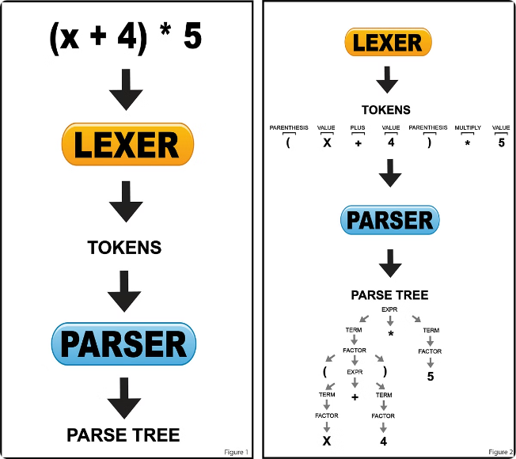
Context-Free Grammars and Languages
1
Definition
Context-free grammars generate a more expressive class of languages called context-free languages.
2
Derivation
Context-free languages are generated by applying production rules to a starting symbol.
3
Applications
Context-free grammars are used in programming language syntax, natural language processing, and data structure representations.

Slide 5

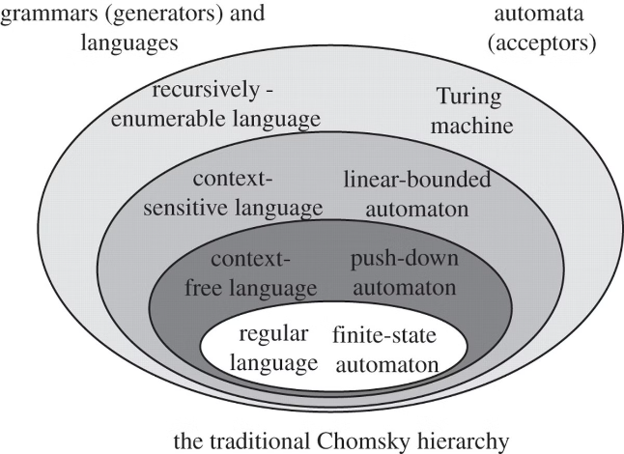
Pushdown Automata
Definition
Stack Memory
Pushdown automata are a computational model that can recognize context-free languages.
Pushdown automata use a stack data structure to keep track of the context-free grammar derivation.
Applications
Pushdown automata are used in compilers, programming language parsers, and natural language processing.

Slide 6

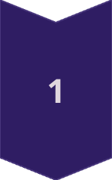
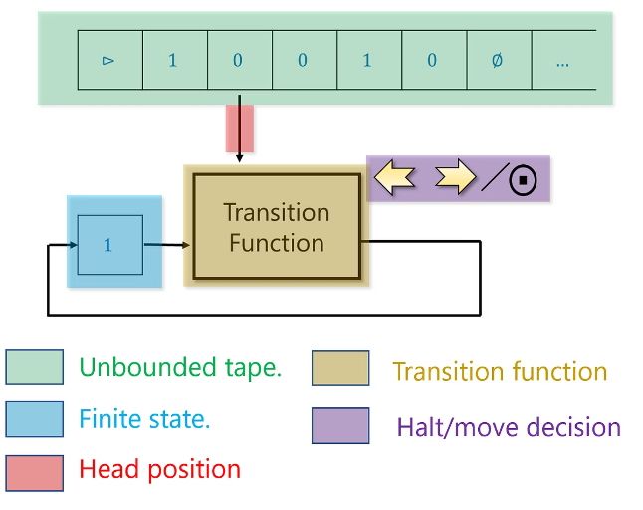
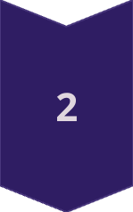
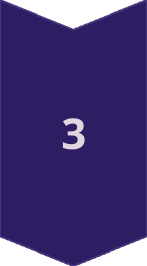
Turing Machines
Definition
Turing machines are a universal model of computation that can solve any computable problem.
Tape and Head
Turing machines have an infinite tape and a read/write head that can move left or right.
Computational Power
Turing machines are the most expressive computational model, able to simulate any algorithm or computer program.

Slide 7


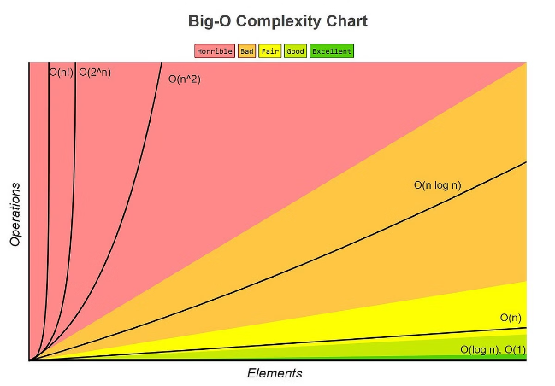


Computational Complexity
Time Complexity
Analyzing the running time of algorithms as a function of input size.
Space Complexity
Analyzing the memory usage of algorithms as a function of input size.
P vs NP
The fundamental open question about the limits of efficient computation.

Slide 8

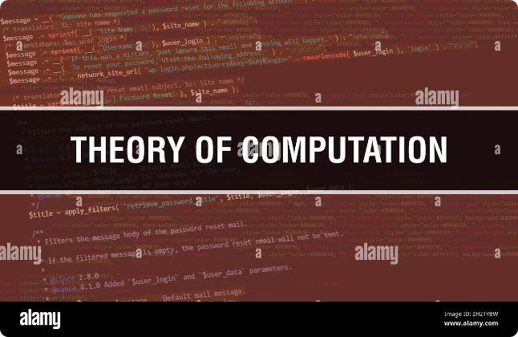
Conclusion and Future Directions
The theory of computation provides a deep understanding of the fundamental capabilities and limitations of computers. As technology advances, this field continues to evolve, driving progress in areas like quantum computing, machine learning, and artificial intelligence.

